Slide 1
Deep Knowledge Tracing
Chris Piech, Jonathan Bassen, Jonathan Huang, Surya Ganguli, Mehran Sahami, Leonidas J Guibas, and Jascha Sohl-Dickstein. Deep knowledge tracing. In Advances in Neural Information Processing Systems, pages 505–513, 2015.

Slide 2
Knowledge Tracing
Bayesian Knowledge Tracing
Other Dynamic Probabilistic Models
Partially Observable Markov Decision Processes
Performance Factors Analysis
Item Response Theory
Deep Knowledge Tracing
Recurrent Neural Networks (RNNs)

Slide 3
Deep Knowledge Tracing
Advantages:
not require the expert annotations
capture more complex representations of student knowledge
Using neural networks results in:
performance improvements
intelligent curriculum design
straightforward interpretation
discovery structure of students tasks

Slide 4
Model: RNN, LSTM
Input
x: a one-hot encoding of the student interaction tuple {q, a}
Output
y: a vector of length equal to the number of problems, where each entry represents the predicted probability that the student would answer the particular problem correctly
Thus the prediction of a_{t+1} can then be read from the entry in y_{t} corresponding to q_{t+1}.

Slide 5


Optimization

Slide 6
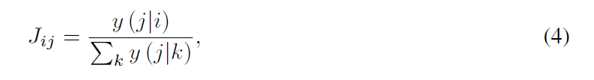
Educational Applications
Improving Curricula
choosing the best sequence of learning items to a student
Curricula are tested by a particle filter with 500 particles where probabilities are drawn from a trained DKT model.
Discovering Exercise Relationships
where y(j|i) is the correctness probability assigned by the RNN to exercise j when exercise i is answered correctly in the first time step.

Slide 7
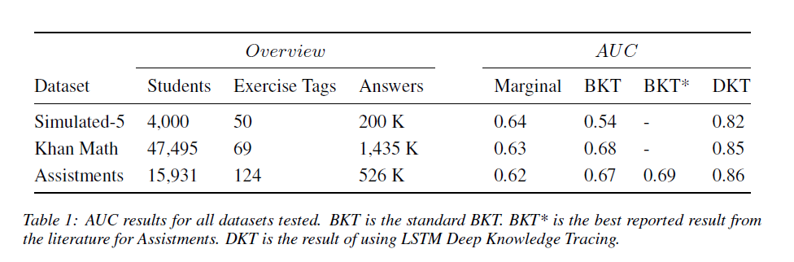
Datasets
Additionally we compare our results to predictions made by simply calculating the marginal probability of a student getting a particular exercise correct.
Notes:
marginal probability?

Slide 8
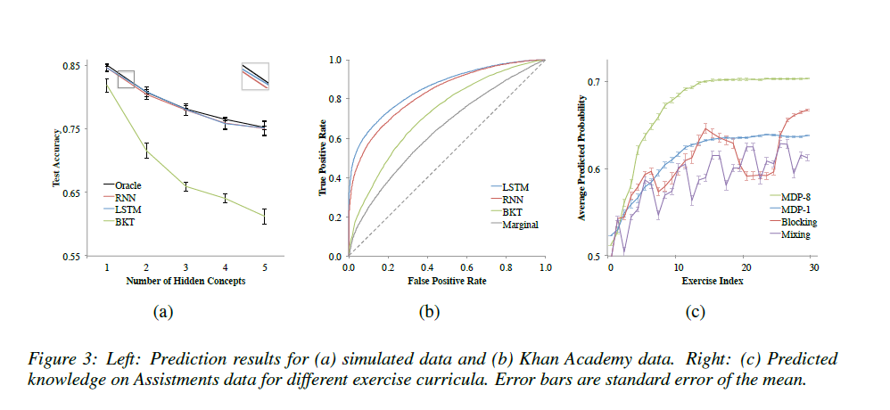
Results
Notes:
oracle？ how to get?
mdp-1, mdp-8?

Slide 9
Expectimax Curricula
Blocking > Mixing
Blocking ≈ MDP-1
Blocking < MDP-8

Slide 10
Discovered Exercise Relationships
An interesting observation is that some of the exercises from the same concept occurred far apart in time.
We restricted the analysis to ordered pairs of exercises {A, B} such that after A appeared, B appeared more than 1% of the time in the remainder of the sequence

Slide 11
